Slide 1
Austin
Transportation
in
20 Slides

Slide 2
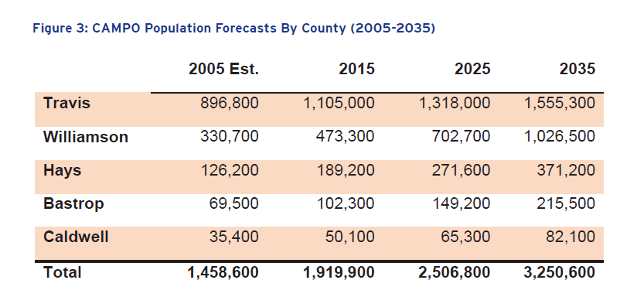
Regional population has grown quickly. And it’s likely to continue.

Slide 3
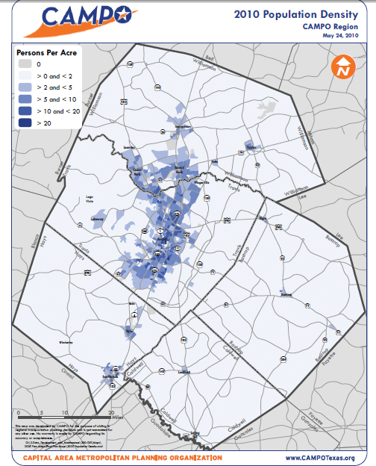
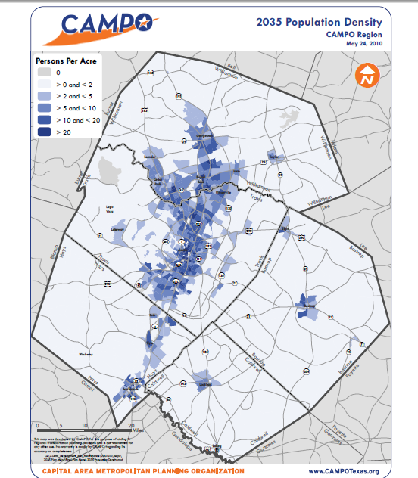
As the population grew, it sprawled.

Slide 4
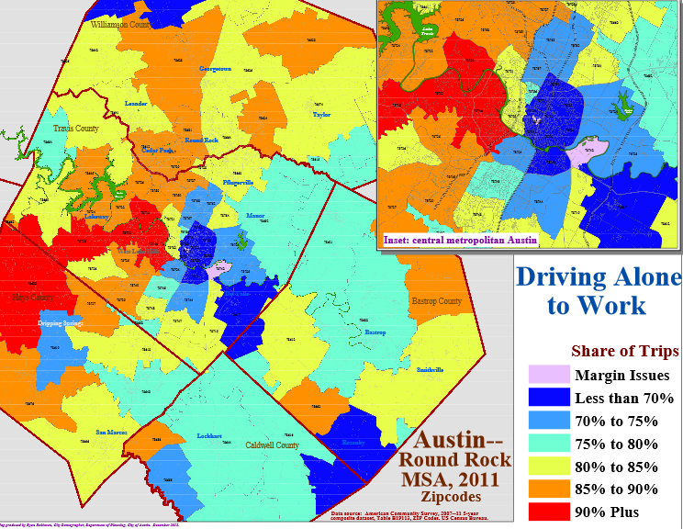
And almost everybody is riding alone to work.

Slide 5
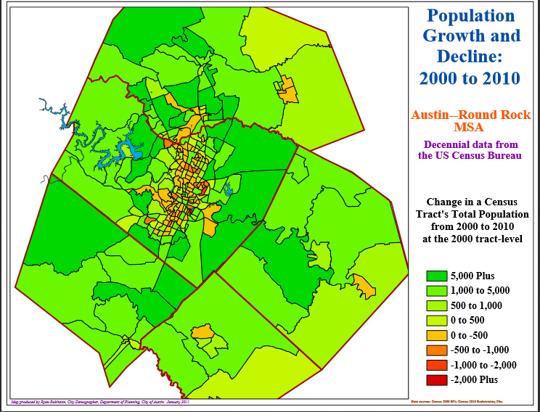
Surprisingly, Austin’s core actually declined in population.

Slide 6
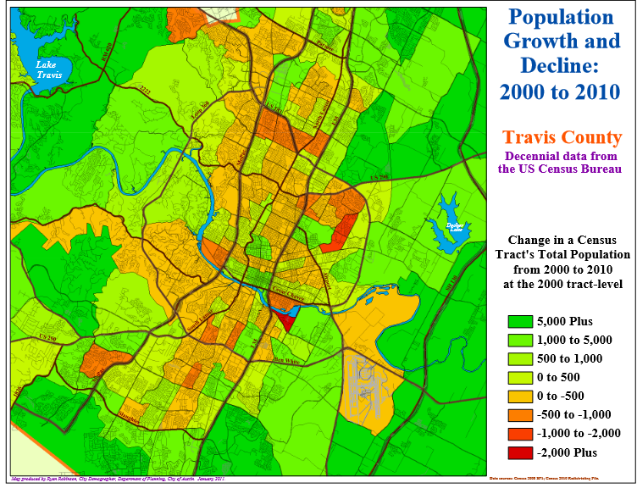
Really, I know it’s surprising, but Austin’s core actually declined in population.

Slide 7
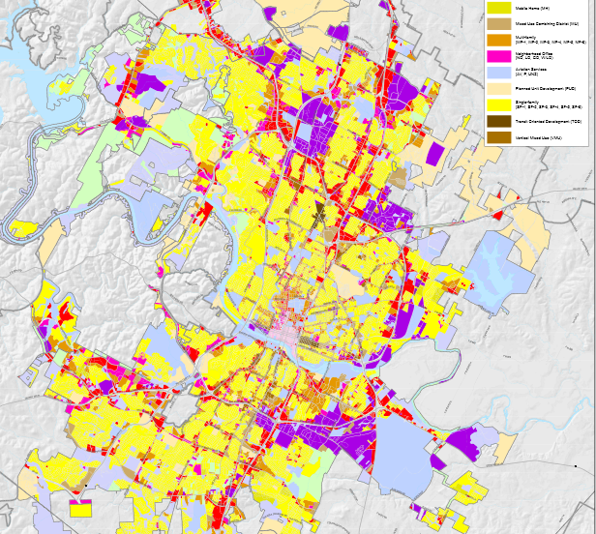
The main reason is regulatory. 11.8% of developed land is zoned multi-family. Just 1.5% of the total has been zoned for high-density multi-family.

Slide 8
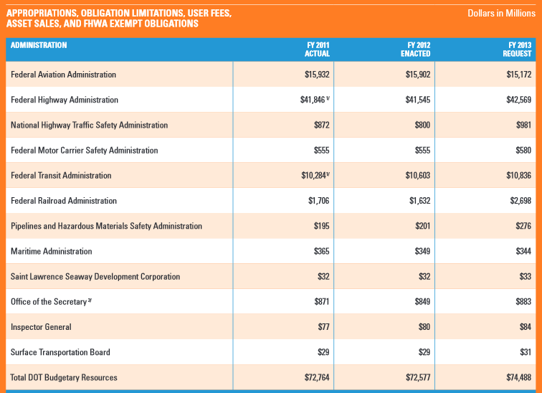
In dealing with our congestion and sprawl, we have to consider available resources. The federal government has a bout $70b in transportation spending. $40b is for highways; $10b is shared by different transit programs.

Slide 9
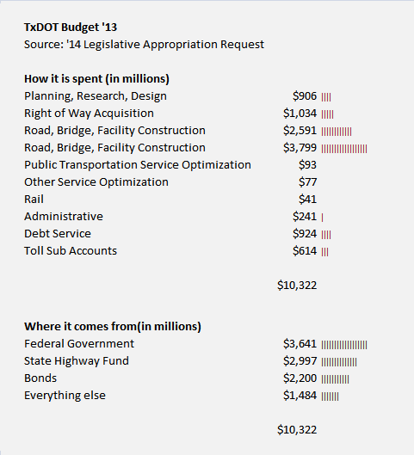
Here in Texas, we overwhelmingly focus our $10b in federal and state revenues on road construction and maintenance.

Slide 10
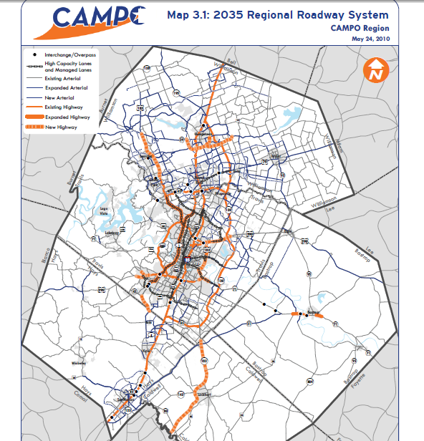
So, not surprisingly, our regional plan spends a lot of resources on expanding roadways towards emerging population centers…

Slide 11
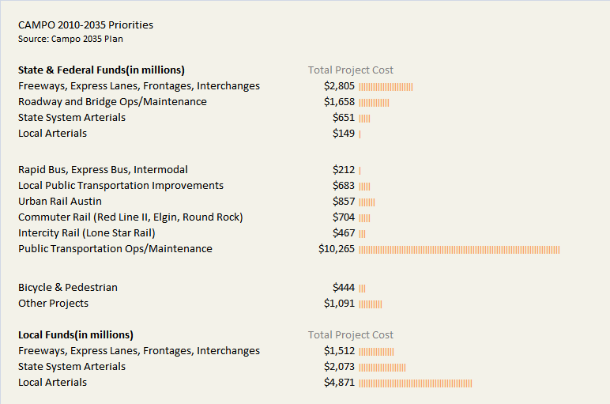
…our regional priorities also include significant allocations for Austin’s urban rail, commuter rail, and the ongoing Operations & Maintenance costs of bus service.

Slide 12
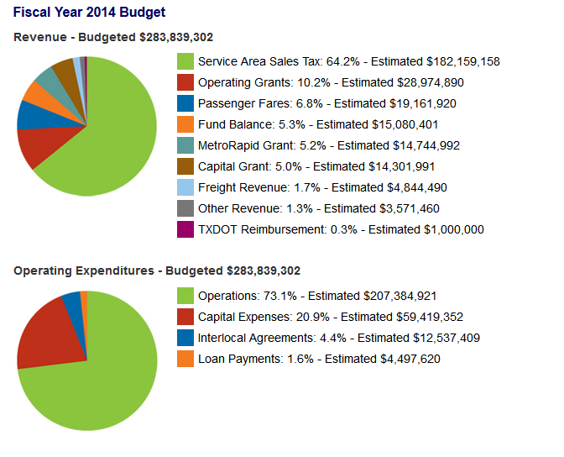
If we drill down into CapMetro, there’s about $210 in operations funding. Half of that is for the bus contract, which is the largest expense.

Slide 13
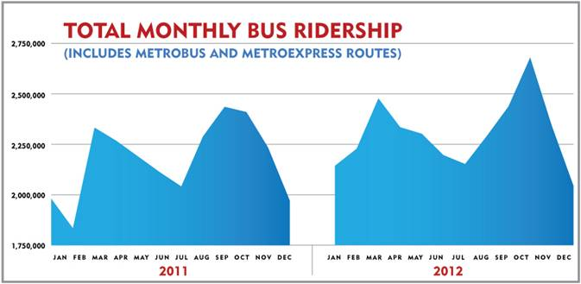
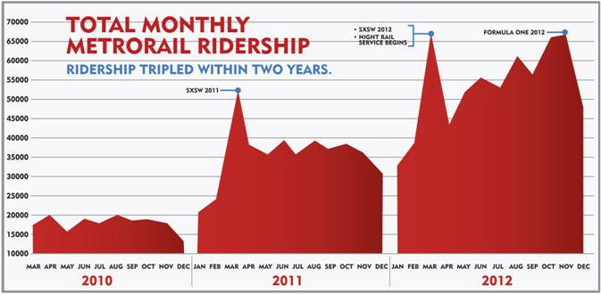
Bus service uses up the money and it is what serves the riders.

Slide 14
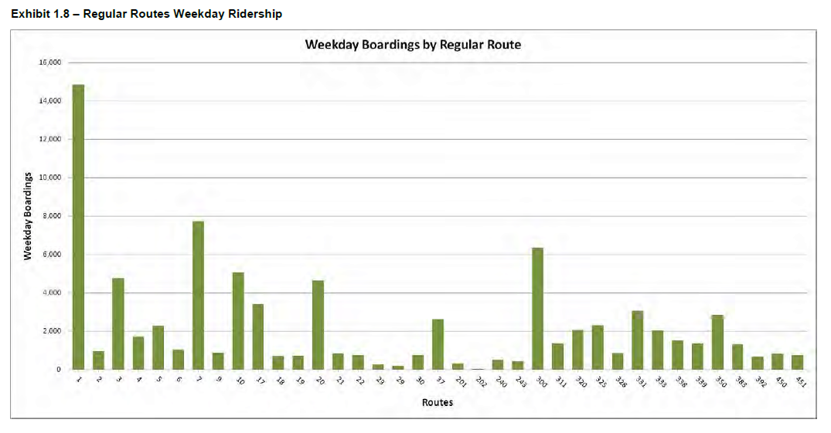
Not all bus routes are the same, though. The service allocation across routes is a key choice.

Slide 15
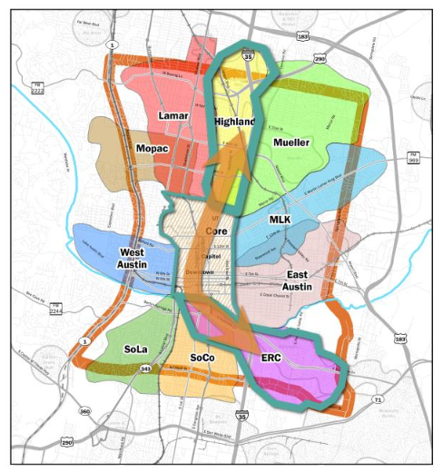
This June, Council and CapMetro will be making another critical choice: the urban rail route.

Slide 16
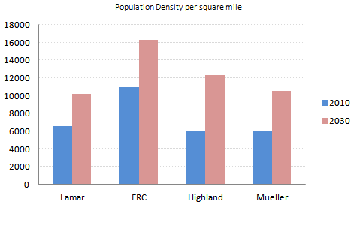
A key issue is where the route will start. ERC and Highland are the finalists.

Slide 17
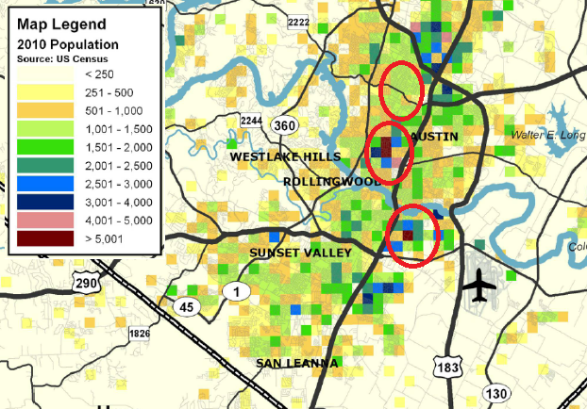
This is a mapping of transit-supportive densities from the Chamber’s mobility report.

Slide 18
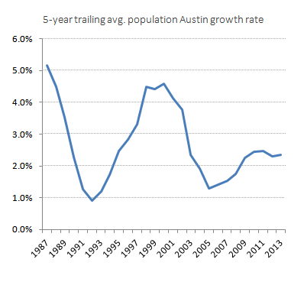
The growth projected for Highland is very high, potentially utterly unrealistic.
HL – 3.6% for 20 years
ATX – 2.7% last 20 years
ATX – 1.9% last 10 years

Slide 19
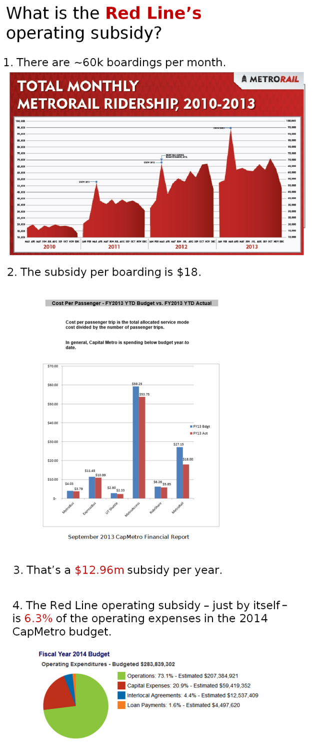
Because of the high fixed costs of rail relative to bus, it is important to avoid low ridership routes.
For example, presently the Red Line consumes funding equivalent to 12% of the main bus service contract, but serves the equivalent of 3% of its ridership.

Slide 20
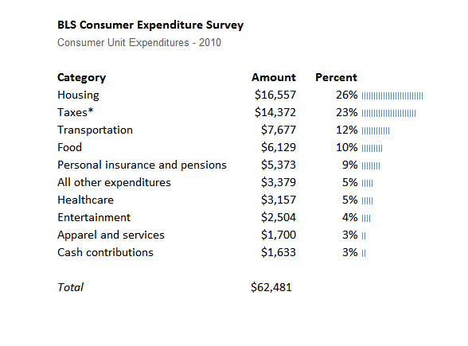
On ‘affordability’, transportation and land-use are the policy levers that really matter.

Slide 21
Extra Material

Slide 22
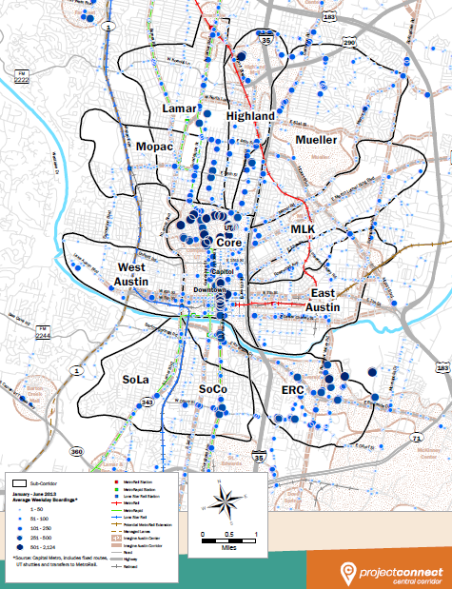

Slide 23
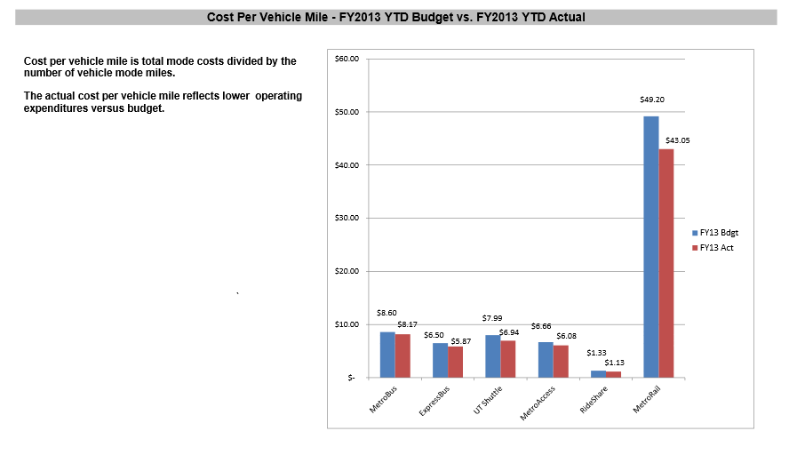

Slide 24
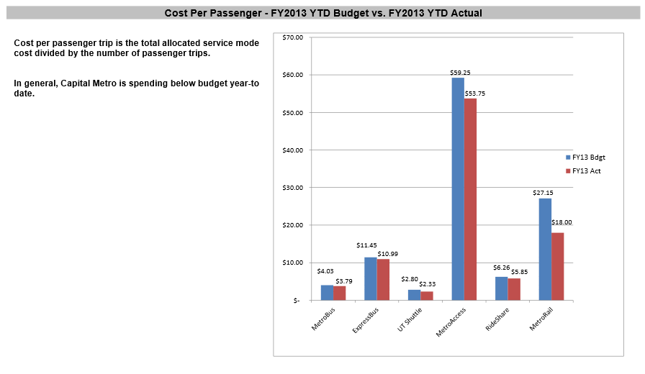

Slide 25
From Austin Contrarian
By Chris Bradford
“Out of nearly 7,900 acres of buildable, undeveloped land in residential districts, less than 10% has been set aside for multi-family. Less than 1% of the undeveloped, buildable land has been reserved for the densest multi-famiy (MF-4, MF-5 and MF-6). Just 1.5 acres -- 0.0189% of the total -- has been reserved for the second-densest district (MF-5), and none at all for the densest (MF-6).
Things are just slightly better when we look at developed land. The city has just shy of 40,000 acres of buildable, developed land in residential districts. 11.8% of this land is zoned multi-family. But, again, just 1.5% of the total has been zoned for high-density multi-family , and just 87 acres (a little over 0.2%) for the highest density MF-5 and MF-6. ”

Slide 26
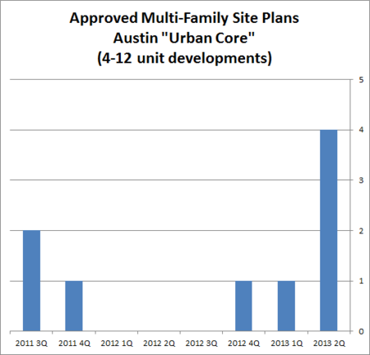
From Austin Contrarian
By Chris Bradford
That's nine approved site plans over a two-year period, with a total of 78 units. (Nineteen of the units, by the way, are in Mueller.)
By contrast, during this same period, the City approved site plans for 26 large apartment/condo buildings within the urban core with a total of 6,641 units. (I'm somewhat arbitrarily defining "large" to mean "more than 100 units").

Slide 27
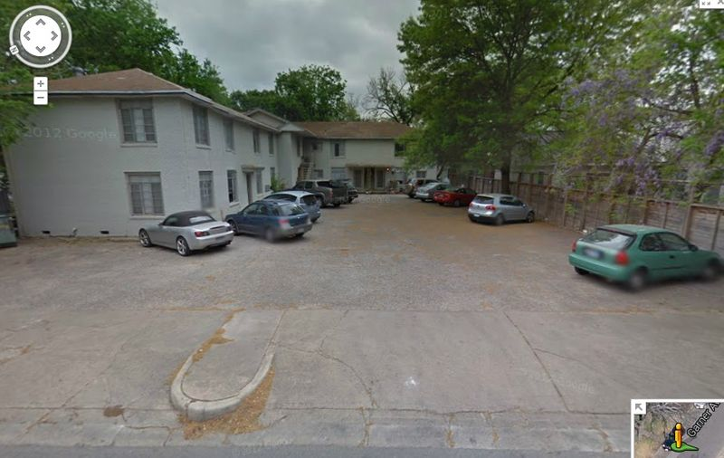

Slide 28
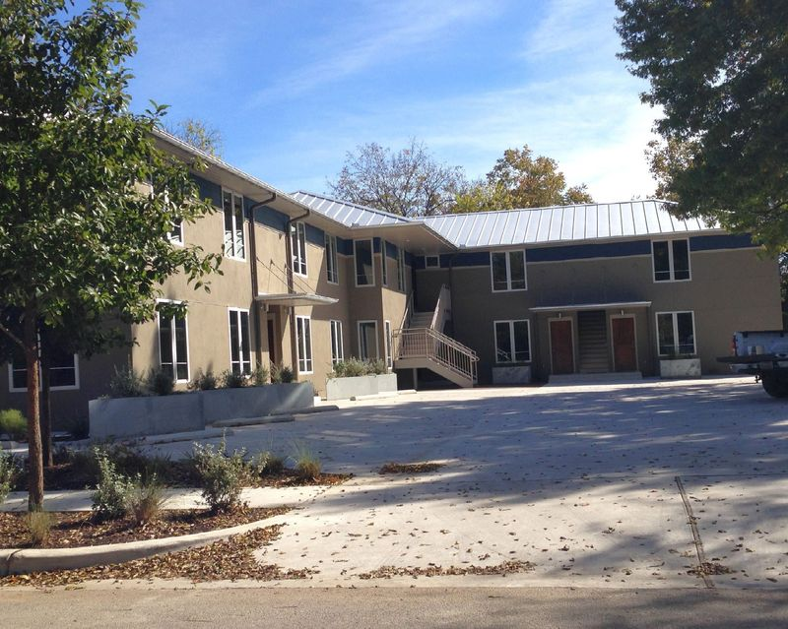

Slide 29
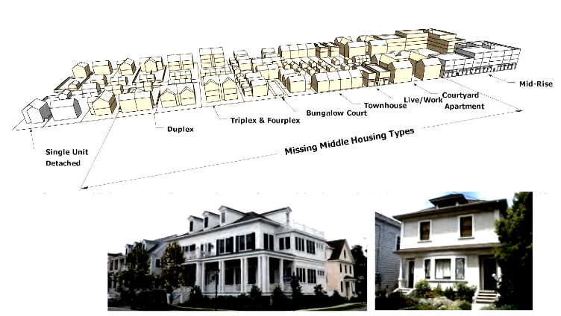

Slide 30
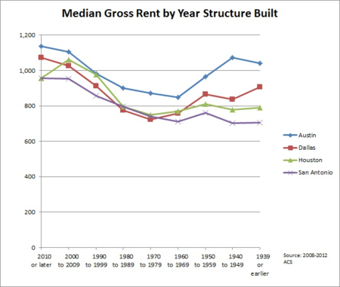

Slide 31
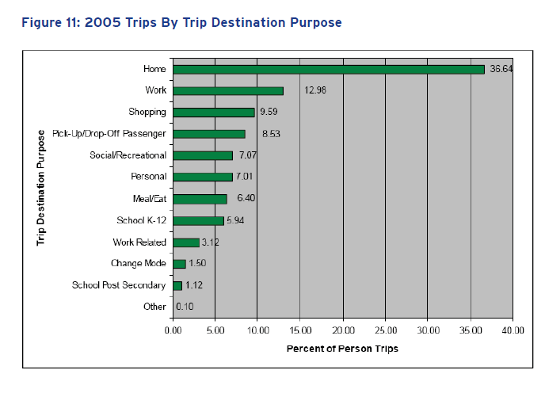

Slide 32
